Slide 1

ManyGiftsUK
Recommender System
Group AA
Anastasiia Tagiltseva
Doris Macean
Doyun Shin
Emil Ahmadov

Slide 2
Business Objectives
E-COMMERCE
Identify buying behavior patterns from customers​
Navigate through large data collections and predicts the possibility that a user would favor an item based on the user’s navigation history:​
Focus on the attributes of the items and give recommendations based on the similarity between them​
Use the "wisdom of crowds" to recommend items
Make recommendations for a new user who has recently entered the system - "cold-start" user problem

Slide 3
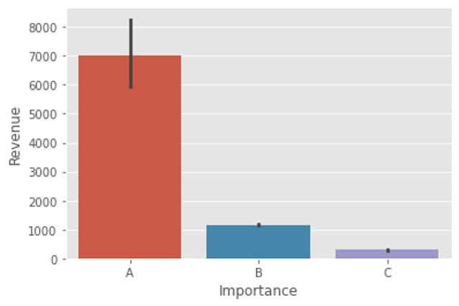
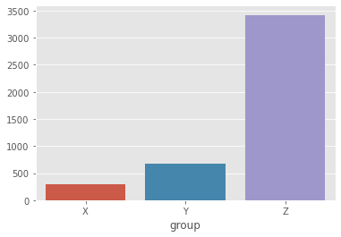
Exploratory
Data Analysis
Number of
transactions
25,900
Number of
products
4,070
Number of
Countries
38
Percentage of
customers NA (new)
24.93%
373 days, 53 weeks

Slide 4
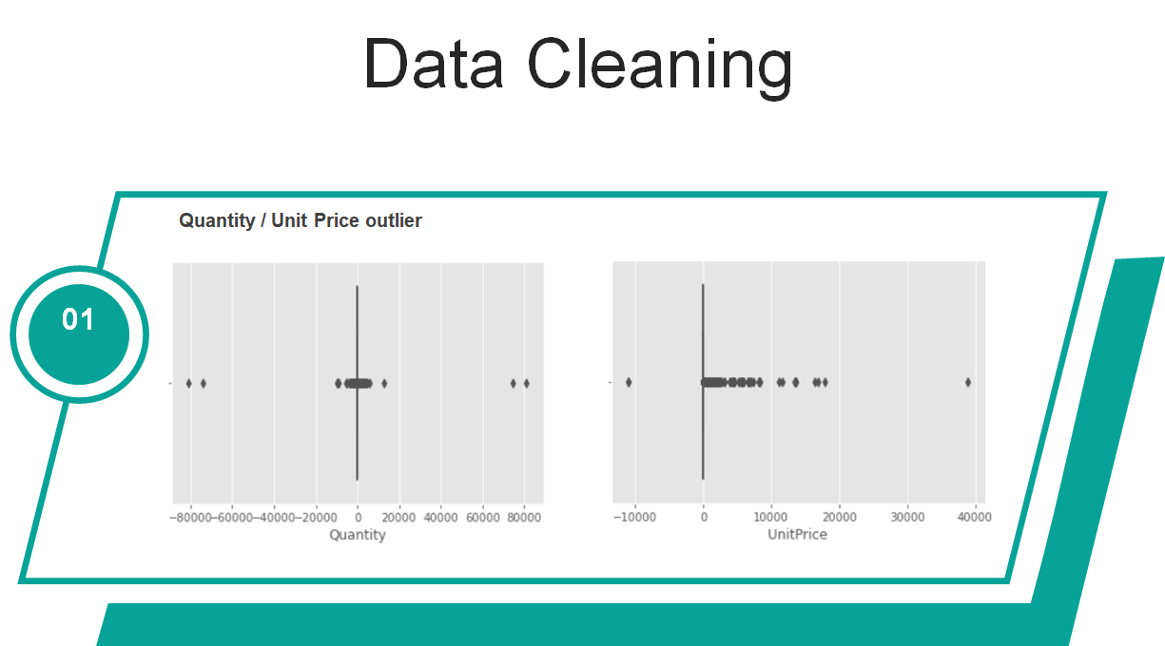

Slide 5
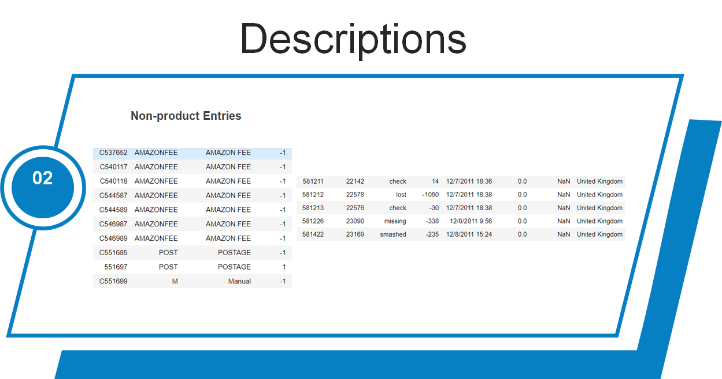

Slide 6
Recommendation Systems
New Customers
Collaborative Filtering
Content Based

Slide 7
Data Modeling
Popular Recommender
Alternating Least Squares
Logistic Matrix Factorization
Bayesian Personalized Ranking
LightFM

Slide 8




ManyGiftsUK
Selected product:
Fairy cake design umbrella
You might like:
Red retrospot umbrella
Feather pen
Polkadot umbrella
Classical rose small vase
Assorted Tutti Frutti Mirror
Folding umbrella
Scented candle
Teatime Teapot

Slide 9
Deployment Plan
Pre-deployment Meeting
Virtual Environment Development
Survey, end.
Focus Group Feedback Collection
Analysis of collected data during the pre-deployment stage to decide implementation design
Pilot Program Survey, start
M-4
M-3
M-2
M-1
Post-deployment
Full Deployment, Stage 3
Full Deployment, Stage 2
Full Deployment, Stage 1
Continuous evaluation.
Periodical in-depth evaluation
Target all visitors
Target Number Expansion
Target random visitors.
Continuous Evaluation
M+x
M+2
M+1
Month

Slide 10
THANK YOU

